Slide 1
Contributing to Django
How I learned to stop worrying and just try to fix an ORM Bug
Notes:
Talk slowly … count to THREE
Good morning, and welcome to my talk, "Contributing to Django … OR How I learned to stop worrying and just try to fix an ORM Bug"

Slide 2
First DjangoCon?
Notes:
How many people are attending their first DjangoCon
ACTION: Get a drink of water
Awesome! And welcome ☺

Slide 3
Introduction
Ryan Cheley
Notes:
My name is Ryan Cheley.
I’ve been using Python for about 7 years now, and Django for about 5 years
I work for a Medical Services Organization in Southern California.
Part of my duties include managing a team of web developers and one of our newer projects is an internal Django App
Today I'm going to talk about the fantastic experience I had in trying to fix a bug in the Django ORM
But first, a side quest
ACTION: Get a drink of water

Slide 4

Notes:
When I was 15 (in 1993) my Boy Scout troop did a trip to Mt Whitney.
There I was at the Mt Whitney Trail Crest, 13,600 ft (4159 m) above sea level
We had spent the 7 days hiking to get here.
I was only 3 miles from the summit of Mt Whitney ... but I wasn't sure I could go any further.
You see, my hiking companions told me I didn't look so good.
Truth be told, I didn't feel so good either.
Did I make it to the summit?
ACTION: Drink Water

Slide 5

Trying to get to DjangoCon US
2018
2019
2020
2021
2022
💼
💼
🦠
🧑🏻‍💻
🧍🏻
🎉
Notes:
I’ll say that getting to DjangoCon US was an awful lot like trying to get to the summit of Mt Whitney
I've been trying to make it to DjangoCon US since 2018
2018: But, I had a work conference I had to attend.
2019: It happened again in 2019
2020: I was *determined* to go in 2020 ... but we all know what happened there
2021: I was able to attend the online version in 2021
2022: And then I finally made it in person 2022 … And it was amazing.

Slide 6
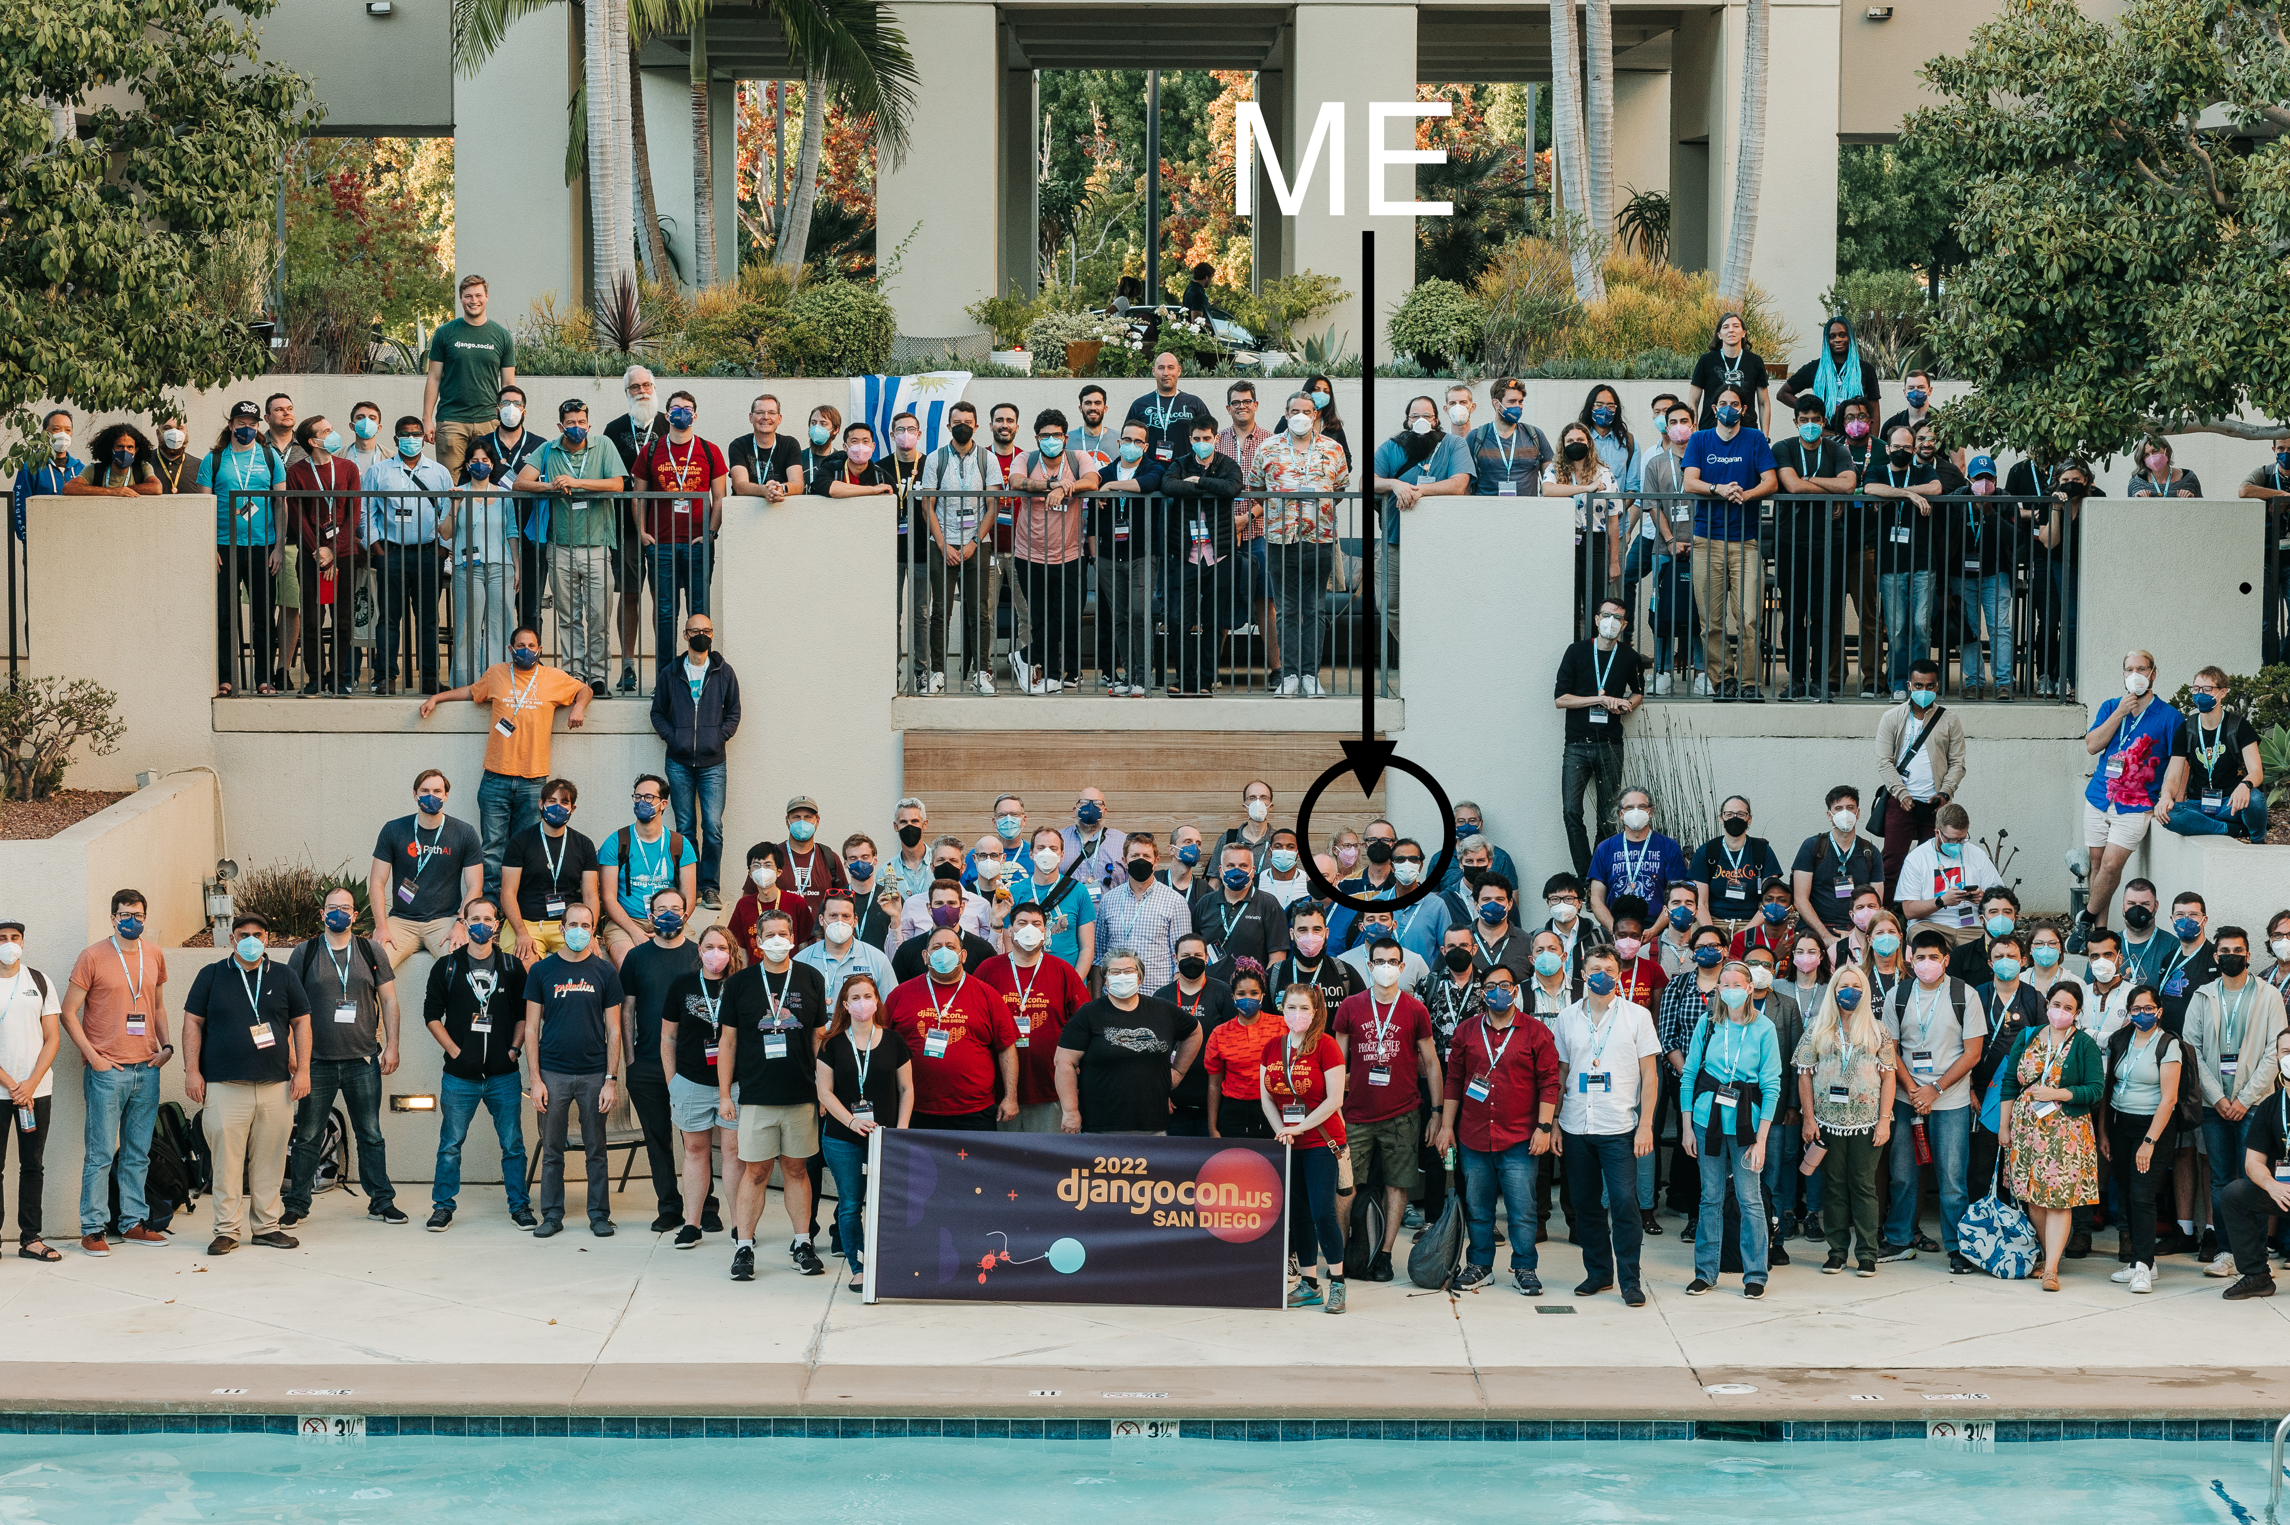
Notes:
This is a shot of all of the participants at DjangoCon US last year in San Diego
And yes, that is actually me circled there
https://www.flickr.com/photos/djangocon/52487681790/in/album-72177720303543873/

Slide 7

Notes:
This is a shot of all of the participants at DjangoCon US last year in San Diego
And yes, that is actually me circled there
https://www.flickr.com/photos/djangocon/52487681790/in/album-72177720303543873/

Slide 8

Notes:
ACTION: Take a sip of water
Here I am … I had *slightly* longer hair then ☺

Slide 9
🏃🏽‍♀️🏃🏻‍♂️🏃🏿
Notes:
I was very excited about attending the sprints and working on *something* ORM related
My strategy for finding a ticket was to find something old, that seemed straightforward(ish) and then just go for it.
I spent some time during the conference
trying to find something,
and by the day of the sprints
I had been able to narrow it down
to a single ticket

Slide 10
Criteria
Old?
January of 2009
Straightforward(ish)
SQLite
Ticket 10070
Title: Named parameters not working on raw sql queries with sqlite
Reported by Matias Surdi
Notes:
Old?
- It was opened in Jan of 2009 making it 13.5 years old at the time of the sprints
Straightforward
- well, it’s related to SQLite which is a bit easier to set up that databases
Ticket 10070
- Named parameters not working on raw sql queries with sqlite
- reported by Matias Surdi

Slide 11
Owner: changed from nobody to Ryan Cheley
Status: new -> Assigned
I’m at DjangoCon US and I’m looking at this Ticket
Notes:
ACTION: Slow Down Count to Three
I assigned the ticket to myself
ACTION: take a sip of water

Slide 12
🔍
Notes:
Reviewing the Ticket
I spent time reviewing the ticket
Then I spoke with Simon Charette about it.
It *seemed* as though it wasn't a problem anymore

Slide 13
My Trac Comment
raw_query\tests
tests that already exist
available
appear to be testing
the ticket is asking for
Notes:
And so, I added a comment to the ticket
In looking at the tests in raw_query\tests (ACTION: hit arrow)
I see a few tests that already exist (ACTION: hit arrow)
These are already available (ACTION: hit arrow)
and appear to be testing the very thing that (ACTION: hit arrow)
the ticket is asking for. (ACTION: hit arrow)

Slide 14
🎉
Notes:
And I marked the Ticket as Done!

Slide 15
Comment
Thanks for looking into this. I can get back to work now :)
By Matias Surdi
The Reporter of the Issue!
Notes:
Later that day a comment was added to the issue thanking me for working on the ticket … from the original reporter for the ticket Matias Surdi

Slide 16
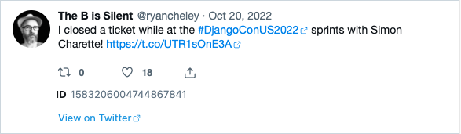
Letting everyone know!
Notes:
I was so excited that I let the world know about it on Twitter / X
I closed a ticket while at DjangoConUS2022 sprints with Simon Charette
ACTION: take a sip of water

Slide 17
🏃🏽‍♀️🏃🏻‍♂️🏃🏿
Notes:
I spent the rest of my time at the sprints
working on other
non-ORM related tickets (a quick documentation update)
in other Django projects (an update to Django Packages to add a View More button to the home page)
I had an amazing time at the conference and the sprints last year, and met some amazing people
as I’m sure you will this year.
When it was all over

Slide 18
🏠
Notes:
I headed home
having been able to close a bug
in the ORM!!!!
ACTION: Take a sip of water

Slide 19

Notes:
And I felt *really* good about this
This is a scene from the James Cameron movie Titanic, released December 19, 1997, when Leonardo Dicaprio’s character says, “I’m the king of the world!”
And that’s kind of how I felt
Funny Story … I’ve never seen this movie

Slide 20
But then …

Slide 21
Another Comment
Broken
mostly for Oracle
Sqlite backend
supports_paramstyle_pyformat
borks
Notes:
ACTION: Slow Down Count to Three
Shai Berger is a member of the Django Security team
Sorry -- this is still broken on Sqlite.
The additions and fixes mentioned are mostly for Oracle and other backends.
The Sqlite backend, at the time I write this,
still has supports_paramstyle_pyformat = False
and still borks with a syntax error if you try to replicate the session in the ticket description.

Slide 22
What is supports_paramstyle_pyformat?
Flag
support 'pyformat' style
("... %(name)s ...", {'name': value})
SQLite this was set to False
Notes:
What is supports_paramstyle_pyformat?
It’s a flag
That indicates if the backend (SQLite, Postgres, Oracle, etc) support 'pyformat' style
("... %(name)s ...", {'name': value})
parameter passing
For SQLite this was set to False

Slide 23
😩
Notes:
Oh No!
I was faced with two potential choices:

Slide 24
🙈🙉🙊
Notes:
Choice 1
Ignore the bug.
It had been a bug for YEARS … it was opened on January 19, 2009 (13 YEARS!!!!)
and didn’t seem to have caused any MAJOR issues

Slide 25
🛠️
Notes:
Or
I could try to Fix it
… Try to work it on my “own”

Slide 26
Feelings …
Notes:
I also had lots of feelings surrounding the discovery of the bug still existing

Slide 27
😳
Notes:
Embarrassed
I declared it fixed on Twitter
I had people at the DjangoCon Sprints ASK ME HOW I DID IT!
ACTION: Take a sip of water

Slide 28
😞
Notes:
Disappointed
I felt like I let people down
I felt like I let *myself* down

Slide 29
😨
Notes:
Fear
Imposter Syndrome – started to sink in
that voice
in the back of my head asking,
“Can YOU work on this on your own?”
“Do you really know what you’re doing?”
ACTION: Take a sip of water

Slide 30
Community
Notes:
But then I remembered a talk that Carlton Gibson gave
at DjangoCon US 2018
Titled
“Your Web Framework Needs You”.
It's a great talk and you should totally watch it,
but here are the highlights that I got out of it

Slide 31
Your Web Framework Needs You!
Ticket difficulty
Time
Thought
Love
Notes:
ACTION: Slow Down … count to Three
1. The vast majority of tickets are no harder than the work you do to solve problems every single day using Django
a. Yes they need, time, thought, and a little bit of your love
b. If you get stuck while trying to solve it you can ask for help!
ACTION: take a sip of water

Slide 32
Your Web Framework Needs You!
The Review Process can be challenging
Same Process
Not Personal
Make the code better
Notes:
2. The review process is challenging
a. … but everyone gets the same review process;
b. it’s not personal
c. Where I work we always try to make the code review about the code and never about the person that wrote the code. We all want the code to be the best it can possibly be, and these code reviews, while challenging, will make the code better AND you’ll more than likely learn something. I found this to be true as I worked on this ticket. It was never about me, but always about making the code better
ACTION: take a sip of water

Slide 33
Your Web Framework Needs You!
You can do it!
Notes:
3. You can do it.
a. You are qualified!
b. If you’ve spent time working on an issue you are the World Expert (ACTION: go to Next Slide)

Slide 34
The World Expert
Wondering
being worked
initial time-boxed investigation
you'll be the world expert TM
Notes:
In June of 2021 Sarah Boyce, who is now a member of the Triage & Review team, posted a comment on ticket 32359:
I was wondering if this is
being worked on or if I could try and pick it up, happy to work on it in a group as well
To which former fellow Carlton Gibson replied
Hi Sarah - you're very welcome to pick it up. :)
I'd suggest an initial time-boxed investigation to work out what the state of play is.
At that point you'll be the world expert TM on this issue, so either you'll have an idea or you'll want input. If you open a PR at that point (even just adding comments in the second case) to explain what's going on, it's easier for others to get up to speed and input

Slide 35
Working on the Ticket
… again
Notes:
I went to work on the ticket
again
I did what most of us probably do
when we’re assigned a Bug for work,
or on a personal project
(and honestly I should have done a better job of when I initially worked the ticket at the sprints)

Slide 36
Write down what you learned 📜
Replicate the Bug 🐛
Read some docs 📖
Write some code ✍🏻
Test the Code 🧪
Notes:
ACTION: SLOW DOWN
Write down what you learned ... as your learning it
Replicate the Bug
Read some docs … which can include Doc strings!
Write some code
Test the code
But before we can write down what we’ve learned, we need to learn some stuff!

Slide 37
🐛
Notes:
Replicate the Bug

Slide 38
Settings.py with psql connection string
DATABASES = {
"default": {
"ENGINE": "django.db.backends.postgresql",
…
}
}
Notes:
First, we set up the connection to point to a Posgres Database
Here we see a standard connection using the postgres Django Database Engine

Slide 39
Steps to Reproduce the Bug: Postgres
>>> from django.db import connection
>>> c = connection.cursor()
>>> c.execute("select app_label from django_content_type where id = 1")
>>> c.execute("select app_label from django_content_type where id = %(id)s", {'id':'1'})
Notes:
The steps to reproduce the bug from the original ticket are, from the repl
When we run this
ACTION: Next Slide

Slide 40
Steps to Reproduce the Bug: Postgres
Runs without error
Notes:
This runs without error … as expected

Slide 41
Settings.py with sqlite3 connection string
DATABASES = {
"default": {
"ENGINE": "django.db.backends.sqlite3",
…
}
}
Notes:
Now, we set up the connection to point to a SQLite Database
Here we see a standard connection using the SQLite Django Database Engine

Slide 42
Steps to Reproduce the Bug: SQLite
>>> from django.db import connection
>>> c = connection.cursor()
>>> c.execute("select app_label from django_content_type where id = 1")
>>> c.execute("select app_label from django_content_type where id = %(id)s", {'id':'1'})
Notes:
This will generate a stack track error

Slide 43
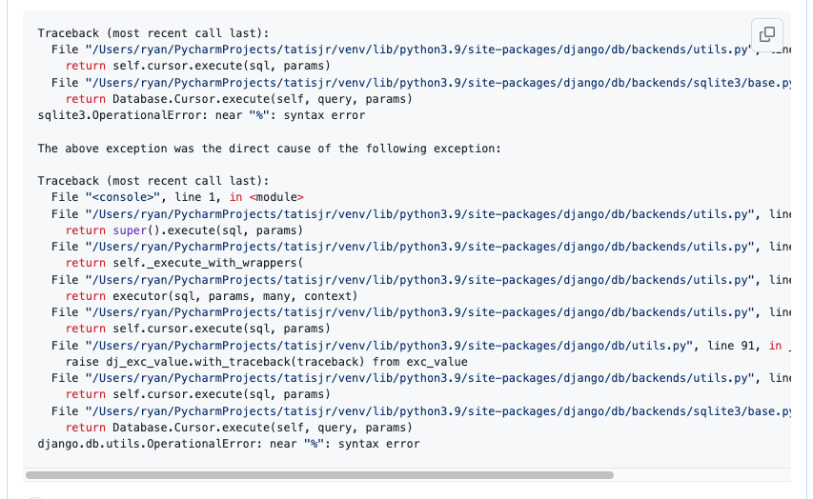
Notes:
ACTION: Slow Down Count to three
And we get this stack trace

Slide 44
Workaround
SQLite supports named parameters
Different Syntax
>>> c.execute("select name from inventory_host where id=:id", {'id': '1’})
>>> Host.objects.raw("select * from inventory_host where id=:id", {'id': '1'})
Consistent
Notes:
A comment posted by Baptiste Mispelon in November 2019 provided a workaround. Their comment was
I don't know how recent it is, but sqlite does support named parameters, albeit with a different syntax
Both of these work on my machine (and they give two commands that work)
c.execute("select name from inventory_host where id=:id", {'id': '1’})
Host.objects.raw("select * from inventory_host where id=:id", {'id': '1’})
Do we want to try and make the syntax consistent across all backends or would it be enough to document the syntax for each one?

Slide 45
Workaround
>>> from django.db import connection
>>> c = connection.cursor()
>>> c.execute("select app_label from django_content_type where id = 1")
>>> c.execute("select * from django_content_type where id = :id", {'id': '1'})
Notes:
When I applied that work around to the code that borked above it does run as intended

Slide 46
✅ Replicate the Bug 🐛
Write down what you learn
Read some docs 📖
Write some code
Test the Code
Notes:
OK, we’ve replicated the bug!
Now, we’re going to read some docs … which can include Doc strings!

Slide 47
📖
Notes:
Read some docs … which includes Doc Strings!

Slide 48
Results of Research
Stack Trace Error Message
File "/Users/Ryan/PycharmProjects/tatisjr/venv/lib/python3.9/site-packages/django/db/backends/sqlite3/base.py", line 357, in execute
return Database.Cursor.execute(self, query, params)
Notes:
The second to last line of the Stack Trace says
django/db/backends/sqlite3/base.py", line 357, in execute
So let’s start at Django.db.backends.sqlite3.base.py on line 357

Slide 49
Results of Research
SQLiteCursorWrapper:
execute
executemany
convert_query
Notes:
When I look at that line in that file I see that there is
a class called SQLiteCursorWrapper
which has three methods:
execute
executemany
convert_query

Slide 50
Results of Research
def execute(…):
…
query = self.convert_query(query, names=param_names)
…
def executemany(…):
…
query = self.convert_query(query, names=param_names)
…
Notes:
ACTION: Next Slide after showing for a few sceonds

Slide 51
Results of Research
BUT
execute
executemany
CALL
convert_query
Notes:
BUT
Since both execute
And execute many
CALL
upon convert_query let’s look there!

Slide 52
Results of Research
def convert_query(self, query):
return FORMAT_QMARK_REGEX.sub("?", query).replace("%%", "%")
Notes:
Here we see the entire method for convert_query
is a single line that uses FORMAT_QMARK_REGEX

Slide 53
Results of Research
BUT
FORMAT_QMARK_REGEX = _lazy_re_compile(r"(?<!%)%s")
Notes:
ACTION: Slow Down Count to three
BUT
FORMAT_QMARK_REGEX = _lazy_re_compile(r"(?<!%)%s")
Which is a lazily compiled regular comprehssion

Slide 54
Results of Research
_lazy_re_compile(regex, flags=0)
Two parameters
regex
flags
re.I
re.S
Notes:
In looking at the helper method _lazy_re_compile() we see that it “lazily compiles a regex with flags” and has two parameters
Regex: The Regular Expression to evaluate
Flags: Flags that modiry the behavior of the regex compilation
Some examples of flags are
re.I: ignore case
re.S: makes the dot character match any character
In our case, we don’t need to worry about the flags though. I included for completeness here

Slide 55
Results of Research: What do we know?
execute() method
convert_query() method
executemany() method
Notes:
OK … so what do we know?
The issue is with the execute method
But that is driven by the convert_query() method
will also likely impact the executemany() method as well

Slide 56
✅ Replicate the Bug 🐛
✅ Read some docs 📖
Write down what you learn
Write some code ✍🏻
Test the Code
Notes:
ACTION: SLOW DOWN

Slide 57
✍🏻
Notes:
Write some code

Slide 58
Ideas for a fix
fails
select * from django_content_type where id = %(id)s", {'id': '1’}
succeeds
select * from django_content_type where id = :id", {'id': '1'}
Notes:
We know from previous slides that this select statement will fail,
while the second one will succeed
SO ... One solution could be to somehow transform the first string into the second, accounting for all of the ways that someone could put in a parameter set.

Slide 59
Ideas for a fix
Regular Expression
Notes:
Use a regular expression to convert the string!

Slide 60
Ideas for a fix
select * from django_content_type where id = %(id)s", {'id': ‘1’}
select * from django_content_type where id = :id", {'id': '1'}
Notes:
ACTION: SLOW DOWN!!!!
We want to go from this
To this
ACTION: Count to Three

Slide 61
My Regular Expression
select * from django_content_type where id = %(id)s", {'id': ‘1’}
select * from django_content_type where id = %(id", {'id': '1’}
select * from django_content_type where id = :id", {'id': ‘1’}
Notes:
We want to replace )s with an empty string
And we want to replace %( with a :, highlighted here
And now we have our final string

Slide 62
My Regular Expression
query = re.sub("\)s", "", re.sub("%\(", ":", query))
Notes:
This transformation can be done with this regular expression

Slide 63
My Regular Expression
posted idea
Notes:
ACTION: Slow Down Count to three
I posted my initial idea to the ticket in Trac

Slide 64
Feedback from Shia Berger
This looks quite fragile
What if string includes `)s`?
Try naming-dict
naming_dict = { param: f":{param}" for param in param_names}
query = query % naming_dict
Notes:
But as the (paraphrased) saying goes (originally attributed to Jamie Zawinski), “I had a problem so I used a Regular Expression and now I have two problems”
ACTION: Take a sip of water
This looks quite fragile
consider, for example a query which, for whatever reason, includes `)s` in a string constant
A more robust approach is to create a naming dictionary from all the parameter names, and use that to format the original text:
naming_dict = { param: f":{param}" for param in param_names}
query = query % naming_dict
Where param_names can be collected either by parsing the query, or from the parameters given.
If this would have been all that was put into the comment I might have been a bit discouraged because honestly, I was a bit confused, but …

Slide 65
Feedback from Shia Berger
Take a look at the Oracle backend
but at the time I knew what I was doing there
Notes:
Shia also left this in the comment
take a look at the Oracle backend -- I wrote that piece too long ago to remember which it takes,
but at the time I knew what I was doing there

Slide 66
Feedback from Simon Charette
Avoid using Regex
Try implementing __getitem__
Ensures _missing_param_ message
instead of KeyError message
Notes:
Similarly Simon Charette said:
I agree with Shai that we should avoid using regex here. He stated in the ticket:
The most straightforward solution I can think of,
I haven't looked at the Oracle implementation in details,
would be to simply implement __getitem__
This will ensure the backend
reports a meaningful low level message regarding _missing_param_
in cases of a parameter is missing
instead of a KeyError
during the Django _translation_ phase
Which should make for a (hopefully) better developer experience in debugging

Slide 67
Original convert_query
def convert_query(self, query):
return FORMAT_QMARK_REGEX.sub("?", query).replace("%%", "%")
Notes:
The original code for the convert_query method is given by
It’s returning the FORMAT_QMARK_REGEX (which is a lazily compiled regular expression)

Slide 68
Incorporating Feedback
Feedback from Shia
naming_dict = { param: f":{param}" for param in param_names}
query = query % naming_dict
Notes:
I need to incorporate the feedback from Shia
Recall the hint given by Shia regarding using the Oracle as a starting point using a naming dictionary

Slide 69
Incorporating Feedback
General Idea
naming_dict = { param: f":{param}" for param in param_names}
query = query % naming_dict
args = {k: ":%s" % k for k in params}
query %= args
Notes:
So applied the feedback to my use case

Slide 70
My initial Code
def execute(self, query, params=None):
…
if hasattr(params, "keys"):
args = {k: ":%s" % k for k in params}
query = query % args
query = self.convert_query(query)
…
Notes:
We see this implemented here.
The if statement checks to make sure that params
is a dictionary like object, so we check the params to ensure “keys” exists using has attr

Slide 71
My initial Code
def executemany(self, query, param_list):
…
param_list = [p for p in param_list]
try:
if hasattr(param_list[0], "keys"):
args = {k: ":%s" % k for k in param_list[0]}
query = query % args
except IndexError:
pass
query = self.convert_query(query)
…
Notes:
I used the same idea here for executemany. Again checking for a dictionary like object and using a list comprehension to get information from the generator param_list

Slide 72
✅ Replicate the Bug 🐛
✅ Read some docs 📖
✅ Write some code ✍🏻
Write down what you learn
Test the Code 🧪
Notes:
ACTION: SLOW DOWN

Slide 73
🧪
Notes:
ACTION: Drink water
Test the code that you wrote

Slide 74
Tests
Current tests
New tests (if needed)
Notes:
Make sure the current tests pass
Write new tests if neccesary

Slide 75
Tests: Make sure current tests pass
supports_paramstyle_pyformat = False
RawQueryTests
test_pyformat_params
test_query_representation
Notes:
ACTION: Slow Down Count to three
OK, as I work through testing the issue I've found a few things:
There is a features file django.db.backends.sqlite3.features which has a DatabaseFeatures class with supports_paramstyle_pyformat value set to False; this was also something that Shia called out in his initial comment
I see a class called RawQueryTests that has two methods
test_pyformat_params
test_query_representation

Slide 76
Tests: Make sure current tests pass
@skipUnlessDBFeature("supports_paramstyle_pyformat")
test_pyformat_params(self):
…
Notes:
BUT, in looking at test_pyformat_params
I see this decorator
@skipUnlessDBFeature("supports_paramstyle_pyformat")
Since supports_paramstyle_pyformat = False for SQLite
This will cause the test to be skipped

Slide 77
Tests: Make sure current tests pass
Add my proposed code
Change supports_paramstyle_pyformat to be True
Notes:
So, in order for the tests to check what is happening it looks like I have to:
Add my proposed code
Change the flag for supports_paramstyle_pyformat

Slide 78
Tests: Write New Tests
Not needed
Notes:
Based on the tests discovered above, it doesn’t look like new tests are needed

Slide 79
Tests
./runtests.py -k test_pyformat_params -k test_query_representation
Notes:
Before changing the code, let’s see the outcome of running the two tests above
So we’ll run just the two tests using this command

Slide 80
Tests: Make sure current tests pass
supports_paramstyle_pyformat = False
test_pyformat_params
test_query_representation
Notes:
Since supports_paramstyle_pyformat = False
The test test_pyformat_params should be skipped
While the test test_query_representation should pass

Slide 81
Tests: Make sure current tests pass
Testing against Django installed in '/Users/ryan/github/django/django' with up to 8 processes
Found 2 test(s).
Creating test database for alias 'default'...
System check identified no issues (17 silenced).
s.
----------------------------------------------------------------------
Ran 2 tests in 0.028s
Notes:
And as expected, here are the test results
One test skipped denoted with the s

Slide 82
Tests: Make sure current tests pass
Testing against Django installed in '/Users/ryan/github/django/django' with up to 8 processes
Found 2 test(s).
Creating test database for alias 'default'...
System check identified no issues (17 silenced).
s.
----------------------------------------------------------------------
Ran 2 tests in 0.028s
Notes:
And as expected, here are the test results
One test passed denoted with the .

Slide 83
Possible States Testing Matrix
Flag = False
Flag = True
Original Code
1 test should pass
1 test should pass
1 test should be skipped
1 test should fail
Updated Code
1 tests should pass
2 tests should pass
🎉
1 test should be skipped
*Flag = supports_paramstyle_pyformat
Notes:
ACTION: Slow Down count to three
When working on testing in a sitation like this, the strategy I use is something I’m calling a Possible States Testing Matrix
What are our possible states?
The original state, that is
Flag is False
With the original code
Here 1 test should pass and 1 test should be skipped
A broken state, that is, when the Flag is set to true with the original code where 1 test should pass and 1 test should fail. This is why the bug exists in the first place!
A ‘check’ state where the flag is set to False, and the code is updated. Here, as in the original state, we should have 1 test pass and 1 test be skipped
And finally, the desired state, where the flag is set to True with the updated code. Here we should have 2 passing tests!

Slide 84
Testing
Run the tests to check new behavior
Run entire test suite
Notes:
While I’m only focusing on two tests during development,
We also need to make sure that the entire test suite passes!

Slide 85
✅ Replicate the Bug 🐛
✅ Read some docs 📖
✅ Write some code ✍🏻
✅ Test the Code 🧪
Write down what you learned 📜

Slide 86
📜
Notes:
ACTION: Slow Down Count to three
Write down what you’re learning as you’re learning … because we all do this, right?
I didn’t until working on this issue.
I was inspired by a talk given by Simon Willison at DjangoCon US 2022 titled,
“Massively increase your productivity on personal projects with comprehensive documentation and automated tests”

Slide 87
Public Notes
Notes:
This talk included an idea called Simon calls ‘public notes’.
I highly recommend watching that talk and implementing the public notes idea
As I said, this was the first time I used the idea,
but I've used it a few more times since then
as I try to learn about a thing.
I’ve even started doing it at my day-job

Slide 88
What are Public Notes
Issue
Work through
problem
Notes:
OK, great, but what ARE Public Notes?
Essentially you use an issue
(in my case a GitHub issue)
as a spot to work through a problem

Slide 89
Public Notes
Tips
Hints
Breadcrumbs
What ever you want to call them
Notes:
and leave yourself tips, hints, breadcrumbs … whatever you want call it
for what you’ve tried and learned,

Slide 90
Scientific Method🧑🏽‍🔬
Notes:
basically doing what you would do
in the ‘scientific method’

Slide 91
My Public Notes
Notes:
In my notes there’s a lot of back and forth, two steps backward, 1 step forward kind of things, but even looking at it now, I can see my thought process for how the bug ended up getting fixed
And honestly, were it not for the Public Notes I’m not sure I would have been able to give this talk

Slide 92
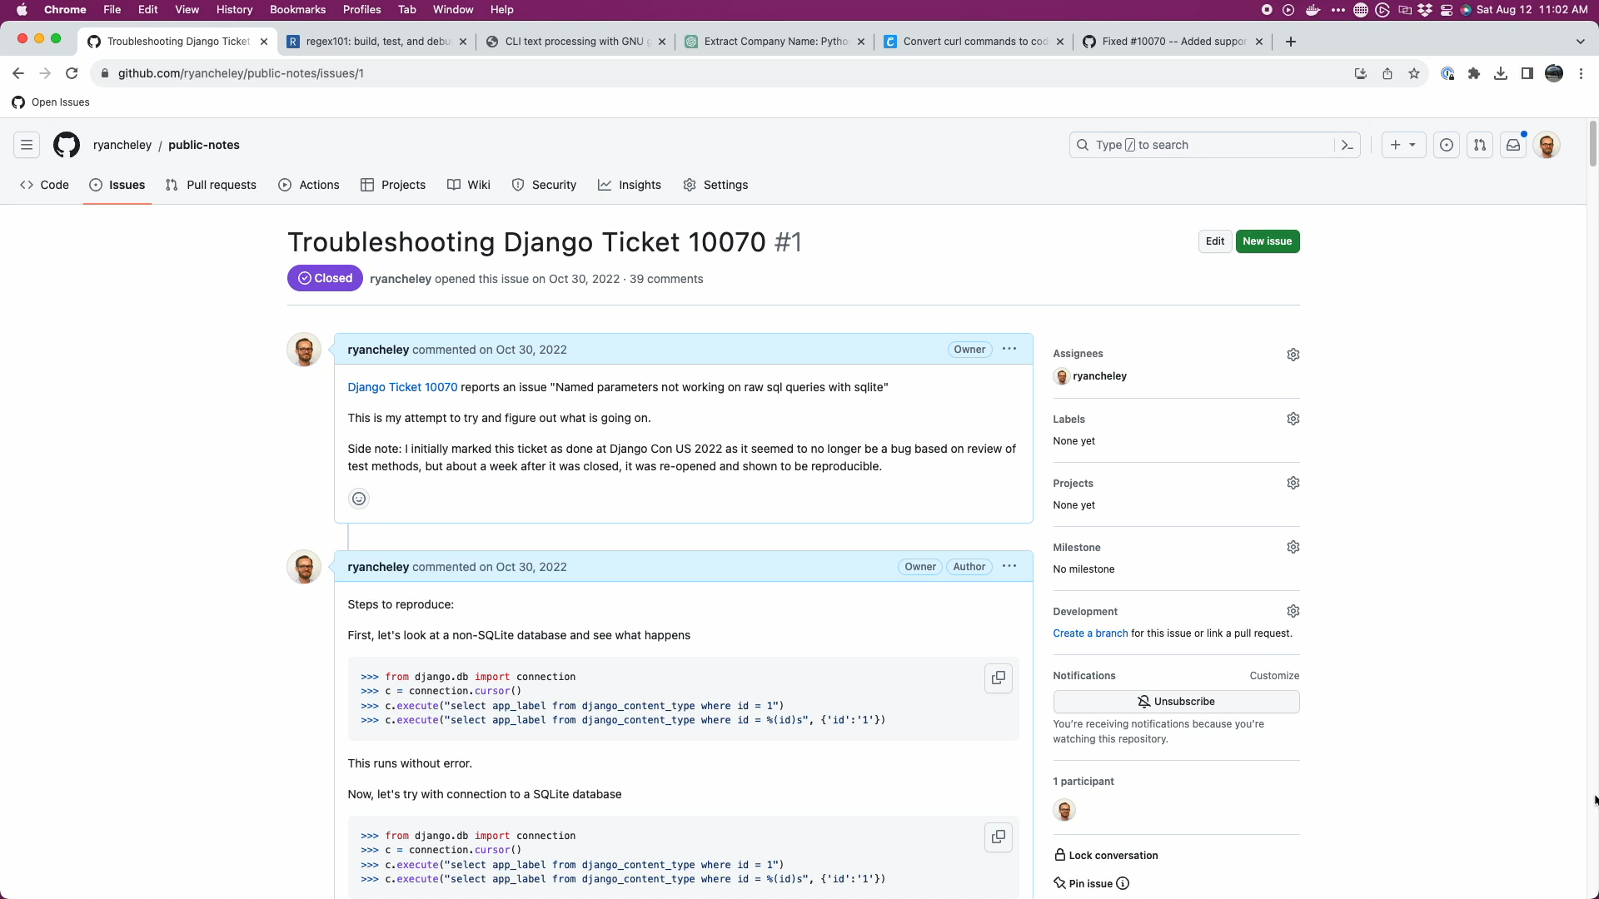
Notes:
Here is a short video of my Public Notes on GitHub
I have 40 comments
as a conversation to myself,
back and forth
from Oct 30, 2022
to Nov 8, 2022
That’s just 10 days …

Slide 93
The fix
Notes:
We’ve spent a bit of time getting here, but what was ‘The Fix’?

Slide 94
Incorporating Feedback
Hint from Shia
naming_dict = { param: f":{param}" for param in param_names}
query = query % naming_dict
Notes:
Recall the feedback given by Shai

Slide 95
Incorporating Feedback
General Idea
naming_dict = { param: f":{param}" for param in param_names}
query = query % naming_dict
args = {k: ":%s" % k for k in params}
query %= args
Notes:
Which I adapted for my use case

Slide 96
My initial Code
def execute(self, query, params=None):
…
if hasattr(params, "keys"):
args = {k: ":%s" % k for k in params}
query = query % args
query = self.convert_query(query)
…
Notes:
And applied to execute

Slide 97
My initial Code
def executemany(self, query, param_list):
…
param_list = [p for p in param_list]
try:
if hasattr(param_list[0], "keys"):
args = {k: ":%s" % k for k in param_list[0]}
query = query % args
except IndexError:
pass
query = self.convert_query(query)
…
Notes:
And applied to executemany

Slide 98
Original convert_query
def convert_query(self, query):
return FORMAT_QMARK_REGEX.sub("?", query).replace("%%", "%")
Notes:
As a reminder, the original code for the convert_query method is given by
It’s returning the FORMAT_QMARK_REGEX

Slide 99
Issue Comment by Nick Pope
Duplication
Potential for incorrect conversion
%(value)s to :value
Also convert %%s to %s
Notes:
Nick Pope added comments to the conversation on the issue in GitHub:
There is duplication
which should be pushed down into `.convert_query()`.
ACTION: next bullet point
Converting `%(value)s` to `:value` in this way will also convert `%%s` to `%s` which will then be incorrectly converted to `?` in `.convert_query()`.

Slide 100
Issue Comment by Nick Pope
Potential for poor performance
Materialized Generator
Pull Request to my Pull Request
Notes:
Converting `param_list` to a `list` in `.executemany()` will saddle us with poor performance.
We many have been passed a generator and the current approach will force all of the parameters to be materialized.
The approach needed requires that we can peek at the first item in the generator without consuming the lot.
ACTION: next bullet point
I'll provide a PR to your branch so that you can see what I mean.

Slide 101
PR from Nick Pope
def convert_query(self, query, *, names=None):
if names is None:
return FORMAT_QMARK_REGEX.sub("?", query).replace("%%", "%")
else:
return query % {name: f":{name}" for name in names}
Notes:
True to his word, Nick submitted a PR against my code
Where the duplicated code was pushed into convert_query

Slide 102
PR from Nick Pope
def execute(self, query, params=None):
…
names = list(params) if isinstance(params, Mapping) else None
query = self.convert_query(query, names=names)
…
Notes:
And updated the execute() method

Slide 103
PR from Nick Pope
def executemany(self, query, param_list):
…
peekable, param_list = tee(iter(param_list))
if (params := next(peekable, None)) and isinstance(params, Mapping):
names = list(params)
else:
names = None
query = self.convert_query(query, names=names)
…
Notes:
And the executemany() method
To incorporate the update to convert_query

Slide 104
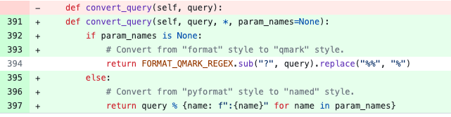
Full Diff
Notes:
ACTION: Count to three

Slide 105
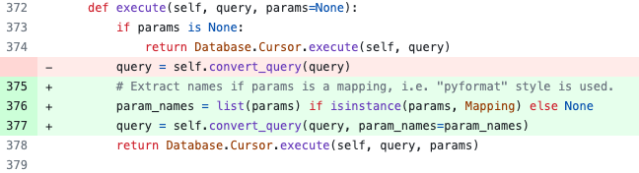
Full Diff
Notes:
ACTION: Count to three

Slide 106
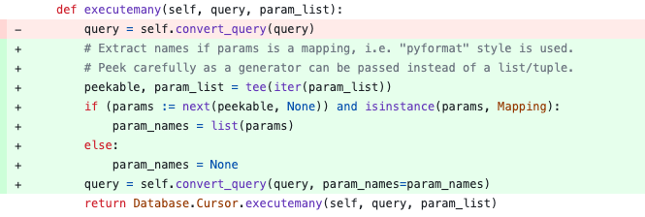
Full Diff
Notes:
ACTION: Count to three

Slide 107
BONUS!

Slide 108
Python SQLite Docs Update!
sqlite3.paramstyle
String constant stating the type of parameter marker formatting expected by the sqlite3 module. Required by the DB-API. Hard-coded to "qmark".
Note: The sqlite3 module supports both "qmark" and ”numeric" DB-API parameter styles, because that is what the underlying SQLite library supports. However, the DB-API does not allow multiple values for the ”paramstyle" attribute
Notes:
ACTION: Slow Down Count to three
Here’s the documentation pre change
With a Note:
The sqlite3 module supports both "qmark"
and ”numeric" DB-API parameter styles,
because that is what the underlying SQLite library supports.

Slide 109
Python SQLite Docs Update!
Note: The sqlite3 module supports both "qmark”, "numeric" and "named" DB-API parameter styles, because that is what the underlying SQLite library supports. However, the DB-API does not allow multiple values for the ”paramstyle" attribute
Notes:
Here’s the updated version of the note AFTER “named” was added thanks to Nick

Slide 110
Python SQLite Docs Update!
Note: The named DB-API parameter style is also supported
Notes:
Since that update other updates have been made
and is now less verbose,
BUT the named parameter style is still a part of the note

Slide 111
The community
Notes:
From this I hope it’s clear that this fix wasn't just implement or made by me
I had a lot of help in getting the code to the right spot.
Shia Berger
Simon Charette
Nick Pope
Mariusz Felisiak

Slide 112

Shia Berger

Slide 113
Identified fragility
Regex should be avoided
Starting point
Notes:
Feedback that the approach had some fragility
that regex should be avoided (with Simon Charette agreeing)
He also gave a place to get started for investigation using a Oracle as a starting point

Slide 114

Simon Charette

Slide 115
Gave great Keynote at DjangoCon US 2022 on the State of the ORM
Awesome introduction on ORM structure at Sprints
Update to the docs!
Notes:
He gave a great keynote at DjangoCon US 2022
And an awesome introduction on the ORM in general at the sprints
And reminded me to ‘Update the docs!’

Slide 116
Nick Pope

Slide 117
PR on my PR to help improve the code
Remove Code Duplication
Notes:
As we saw above, the PR that Nick did against my code helped improve it dramatically!
It removed code duplication and pushed down that duplicative code to the convert_query() method

Slide 118

Mariusz Felisiak
Notes:
ACTION: Slow Down Count to three

Slide 119
Simplified comments
Merged the PR
Notes:
Simplified some of the comments in the code
And ultimately was the one that merged the code into Django

Slide 120
Experience
GREAT experience
I learned a TON about
SQLite
The ORM
Python
Public Notes
Notes:
I hope I’ve been able to convey what a positive experience this was for me
I also hope I’ve been able to convey how much I’ve learned
This process taught me more about
SQLite – it does ACTUALLY support pyformat style
The Django ORM – specifically how it’s structured in the code and how to better reason about it
Python – generators … up to this point I didn’t really understand them (and maybe I don’t still 100%) but I’m closer not because of the work I did on this ticket
Started using Public notes to learn about a thing. Public notes since then have included:
Upgrading my Digital Ocean servers OS
Installing Python 3.11 on a Raspberry Pi
Figuring out how SSH keys work

Slide 121
Contributions Since
Django Packages
Documentation improvements
Code Reviews
Pelican-Plugins
New Plugin PR opened
Notes:
This was a great experience, and you may think that since then I’ve made tons more contributions.
BUT
I’ve not had an opportunity to contribute again to Django since then … sometimes life gets in the way.
But I have contributed to a couple of other open source projects
Django Packages
- Documentation improvements
- Code Reviews
Pelican Plugins
Pelican is a Python static site generator
- implementing a SQLite search of Pelican using datasette
Datasette is a tool for exploring and publishing data

Slide 122
Contributions Since
Implemented Django at my employer
Admin
MS SQL
Notes:
Implemented Django at DOHC
- using the admin to manage ‘administrative’ tables
- using several MS SQL databases on a couple of different servers

Slide 123
Lessons

Slide 124
The ORM can seem BIG and SCARY
Notes:
ACTION: Click and let the words come on the screen
The ORM can seem big and scary

Slide 125
The Code for Django can seem BIG and SCARY
Notes:
ACTION: Click and let the words come on the screen
The code for Django can seem big and scary

Slide 126
But remember

Slide 127
The Django ORM …

Slide 128
Is Python

Slide 129
In fact, all of Django …
Notes:
ACTION: Slow Down Count to three

Slide 130
Is Python

Slide 131
Looking at Tickets
Notes:
So when you’re ready to go look for a ticket to work on
Whether it’s
ORM related or NOT,
remember
that there is an amazing community here
that wants to see you succeed …

Slide 132
Look At 👀
Read 📖
Write ✍🏻
Notes:
and at the end of the day
the code you’re going to
look at,
read,
and write

Slide 133
Is Python

Slide 134
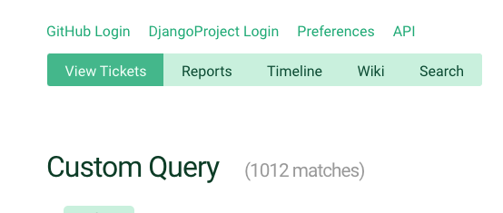
Notes:
So just keep that in mind
when you’re ready to dive in
to one of the currently <> open tickets
https://code.djangoproject.com/query?owner=~nobody&status=assigned&status=new&col=id&col=summary&col=status&col=owner&col=type&col=component&col=version&desc=1&order=id

Slide 135

Notes:
And because this is Django,
there is great documentation
on how to triage tickets
and work through them

Slide 136
Notes:
Back to Mt Whitney
As I said before, I was **only** three miles from the summit, but I just wasn’t feeling **it**.
My fellow hikers didn’t discourage me from continuing, but they didn’t really encourage me either.
I didn’t make it to the summit that day and it’s been a regret ever since.
I’ve not attempted another big hike like that
But why am I telling this story? What does this have to do with fixing a bug in the Django ORM.

Slide 137
🙈🙉🙊
Notes:
When the bug wasn’t resolved I had an option to ignore it … to give up like I did that day at Trail Crest on Mt Whitney
I could have NOT gone to the “summit” of fixing the BUG

Slide 138
🛠️
Notes:
But the community helped me to work through it.
The solution that was ultimately submitted
and merged wasn’t just mine, it was through the hard work of several people.
This community wants you to succeed. They want you to learn.

Slide 139
Notes:
ACTION: Slow Down Count to three
If this community had been up there with me that day,
I’m 100% sure
that I would have made it to the summit
because of the encouragement that is provided
and the determination to want **you** to succeed

Slide 140
So remember …

Slide 141
Your Framework needs YOU

Slide 142
Community
Notes:
And there’s a great community to support you and wants to see you succeed and learn

Slide 143
Sprints 2023
Development Sprints
Contribution Sprints
Notes:
This year, there will be both
Development Sprints and
Contribution Sprints.
If you’re looking to get involved, this is a great opportunity to do so and I highly encourage you all to go.
Hope to see you there

Slide 144
Acknowledgements
Katie McLaughlin
Web Developer Team
Bookie
Chris
Jason
Jon
Abigail Cheley
Notes:
I’d like to Thank a few people that helped me with this presentation. Without their help this presentation wouldn’t be what it is
Don’t read the names, just hit the button

Slide 145
Thank you

Slide 146
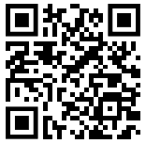
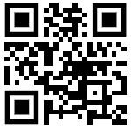
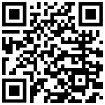
Find me on …
Platform | QR Code
Mastodon https://mastodon.social/@ryancheley
GitHub https://github.com/ryancheley/
LinkedIn https://www.linkedin.com/in/ryan-cheley/

Slide 147
Reference Links
Item
Your Web Framework Needs You! (Slide XX/27) https://www.youtube.com/watch?v=8eYM1uPKg7c
Increase your productivity on personal projects with comprehensive docs and automated tests – DCUS (Slide XX/47) https://www.youtube.com/watch?v=GLkRK2rJGB0
My Public Notes (Slide XX/49) https://github.com/ryancheley/public-notes/issues/1
Keynote: State of the Object-Relational Mapping (ORM) with Simon Charette (Slide XX/56) https://www.youtube.com/watch?v=HNlGFrIBl8o
Django Triaging Tickets (Slide XX/100) https://docs.djangoproject.com/en/dev/internals/contributing/triaging-tickets/

